Slide 1
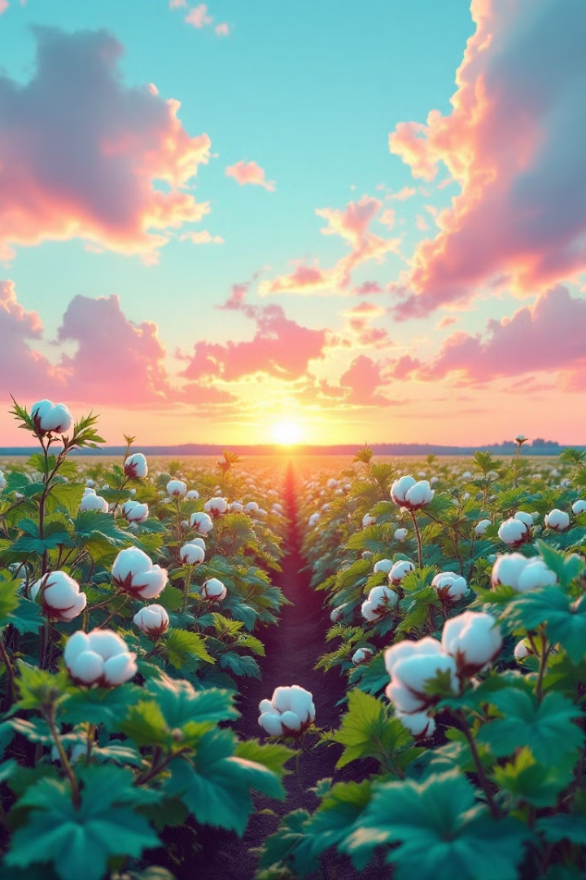

The Textile Industry of Pakistan
Pakistan's textile industry is a cornerstone of the national economy, contributing significantly to employment and foreign exchange earnings. It is a complex and intricate process, involving multiple steps from cotton cultivation to garment manufacturing, each stage playing a vital role in delivering quality products to global markets.
by Muhammad Arslan Sarwar

Slide 2
Cotton Cultivation: The Foundation of the Industry
Ideal Climate and Modern Farming
Government Support and Rural Development
Pakistan's climate is ideal for growing high-quality cotton. Farmers utilize modern farming practices and technologies to maximize production and ensure quality.
Government support through subsidies and programs assists farmers, providing employment and income for rural communities, boosting the economy.

Slide 3
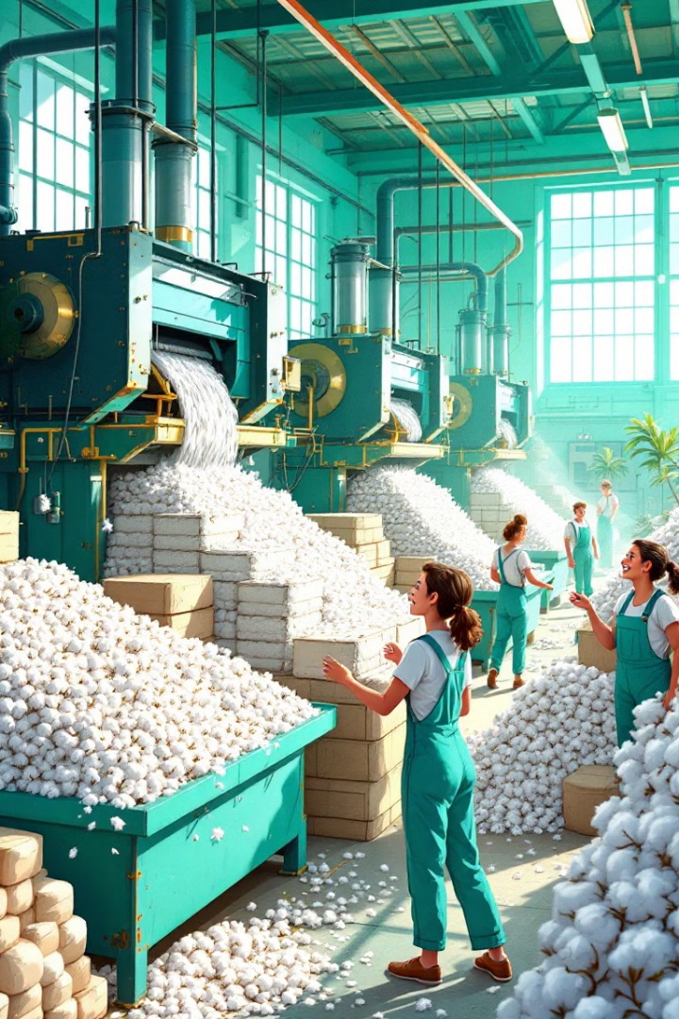
Ginning: Separating Fibers from Seeds
1
Cleaning and Drying
2
Fiber Separation
The cotton is then fed into a ginning machine that separates the fibers from the seeds, leaving the cotton fibers ready for further processing.
Raw cotton is first dried and cleaned to remove impurities such as dirt and leaves.
3
High-Quality Fiber Production
Modern machines are used to ensure a swift and efficient process, producing high-quality cotton fibers for yarn and fabric production.

Slide 4
Spinning and Weaving: Transforming Fibers into Fabric
Yarn Production
Fabric Creation
The cotton fibers are spun into yarn, with various types produced, including combed cotton, carded cotton, and blended yarns.
Advanced looms are used to weave the yarn into fabric, with precision and efficiency, producing various textures and patterns for diverse applications.

Slide 5
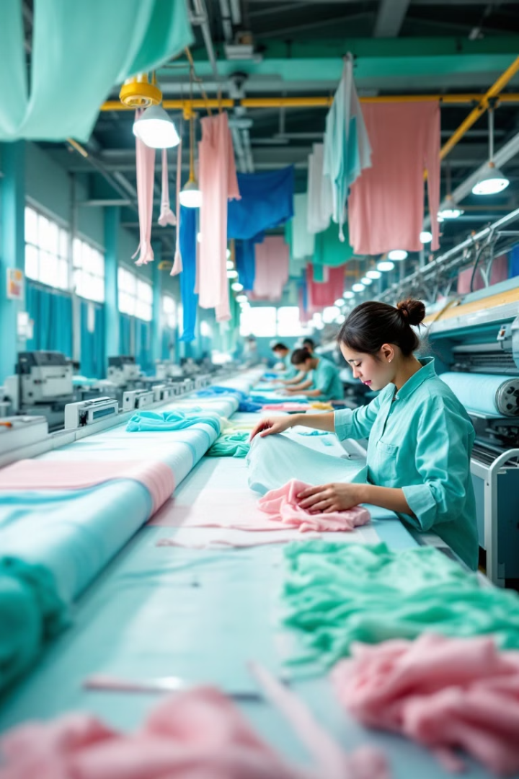




Textile Processing: Enhancing Fabric Properties
Bleaching
Dyeing
Bleaching is used to remove natural pigments from the fabric, creating a blank canvas for dyeing or printing.
Dyeing involves immersing the fabric in a colored solution to add color and enhance its appearance.
Printing
Finishing
Printing involves applying patterns and designs to the fabric using various techniques, adding visual appeal and enhancing its aesthetic.
Finishing treatments add durability, water resistance, or other desired properties to the fabric, enhancing its functionality.

Slide 6
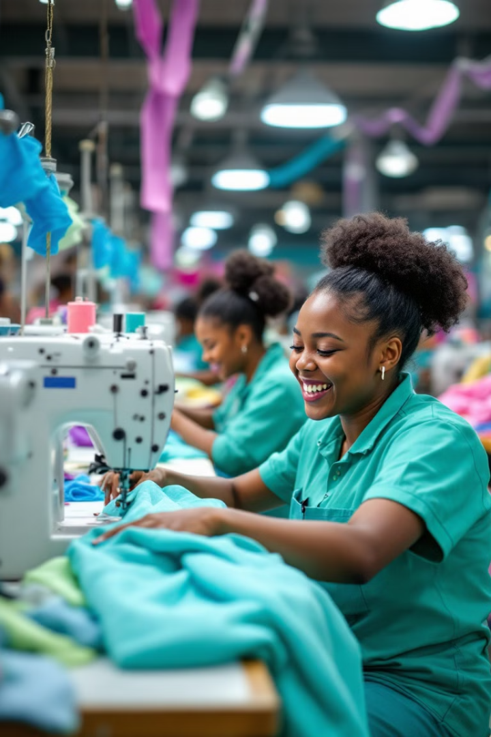
Cutting and Sewing: From Fabric to Garment
1
Pattern Making
Skilled workers create patterns that define the shapes and sizes of the garments.
2
Fabric Cutting
The fabric is carefully cut according to the pattern to ensure accurate dimensions and precise shapes.
3
Stitching and Assembly
The cut fabric pieces are stitched together to form the garment, with meticulous attention to detail and quality control.

Slide 7
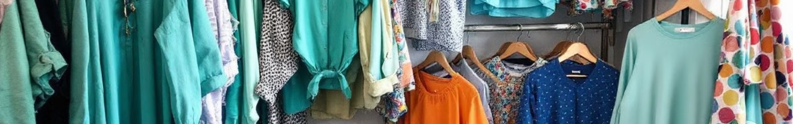
Garment Manufacturing: Delivering a Diverse Range of Products
Knitted Garments
Woven Garments
Knitted garments are made from yarn that is interloped together to form a fabric, often used for casual and sportswear.
Woven garments are made from yarn that is interlaced at right angles to create a fabric, used for more formal and durable apparel.
Household Textiles
Industrial Textiles
The industry also produces household textiles like bed linens, towels, and curtains, catering to diverse needs and preferences.
Pakistan's textile industry also produces industrial textiles used in various sectors such as agriculture, construction, and manufacturing.

Slide 8
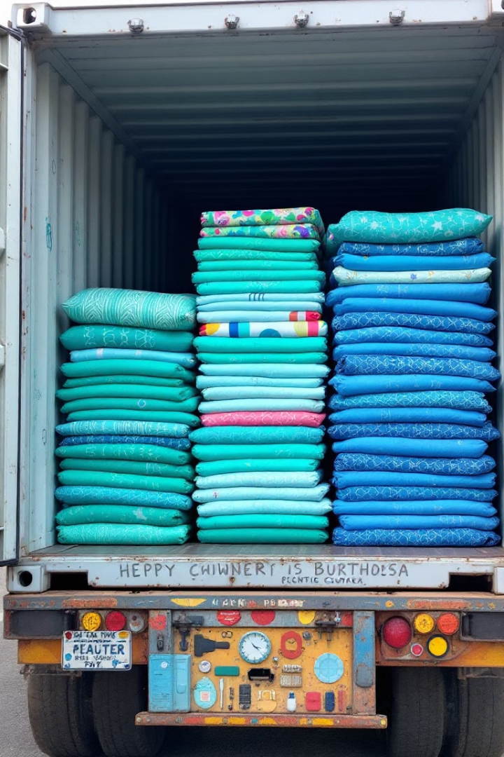
Exporting Quality Products to the World
$16.655 Billion
1
Textile Exports
United States
Pakistan's textile industry generates substantial revenue through exports, a testament to its quality and competitive pricing.
The US is a major export market for Pakistani textiles, appreciating their quality and durability.
2
3
China
United Kingdom
Pakistan's textile exports to China are significant, reflecting strong trade relations between the two countries.
The UK remains a key export market for Pakistani textiles, with a long-standing trade relationship.

Slide 9
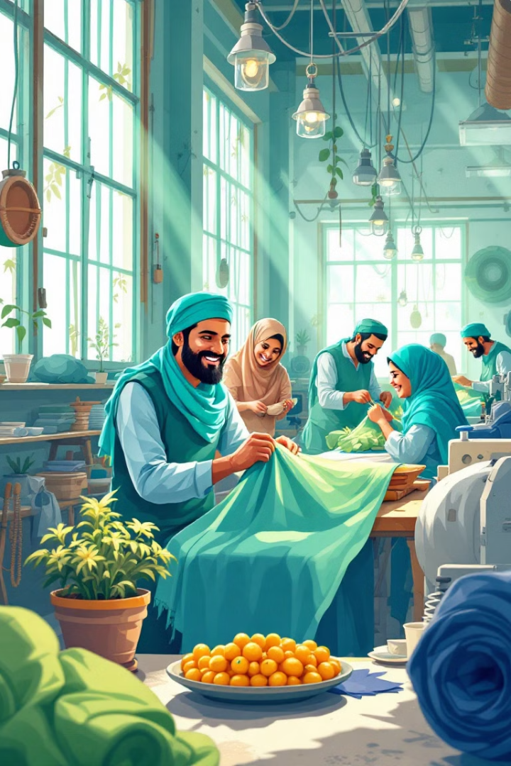
Issues Related to Pakistan’s Textile Industry
Pakistan's textile industry is a cornerstone of its economy, contributing significantly to GDP, employment, and exports. Despite a rich history and strong potential, the industry faces numerous challenges that hinder its growth and competitiveness.

Slide 10
Challenges Faced by the Textile Industry
1
Energy Crisis
2
Infrastructure Challenges
3
Outdated Technology and Machinery
4
Lack of Skilled Labor
5
Environmental Concerns
6
Competition from Other Countries

Slide 11
Energy Crisis: A Major Hurdle
1
High Energy Costs
2
Frequent Power Outages
3
Limited Access to Renewable Energy
Pakistan's textile industry faces high energy costs due to limited natural gas and reliance on expensive imported fuel.
Unreliable power supply disrupts production, leads to inefficiencies, and affects product quality.
Insufficient investment in renewable energy sources hampers efforts to reduce reliance on fossil fuels.

Slide 12

Infrastructure Deficiencies: A Drag on Efficiency
1
Aging Roads and Ports
2
Expensive Transportation
3
Modernization Needed
Pakistan's roads, ports, and storage areas are outdated and require significant investment.
This makes transporting goods difficult and expensive, impacting the industry's ability to compete in global markets.
Improving infrastructure would enhance efficiency and productivity, reducing delays and costs.

Slide 13




Outdated Technology: A Barrier to Progress
Modernization
Automation
Cost Reduction
Pakistan's textile industry relies heavily on outdated technology and machinery, leading to inefficiencies and reduced productivity.
Upgrading to automated machinery, computer-aided design (CAD), and other advanced technologies would enhance production capabilities and improve quality.
Modernization would also help reduce costs, improve efficiency, and enhance competitiveness in the global market.

Slide 14



Skill Gap: A Challenge for the Workforce
Upskilling
1
The lack of skilled labor and workforce training poses a significant challenge to Pakistan's textile industry.
Training
2
Workers need training to improve skills and adapt to new technologies.
Productivity
3
Training would increase productivity, efficiency, and competitiveness.

Slide 15
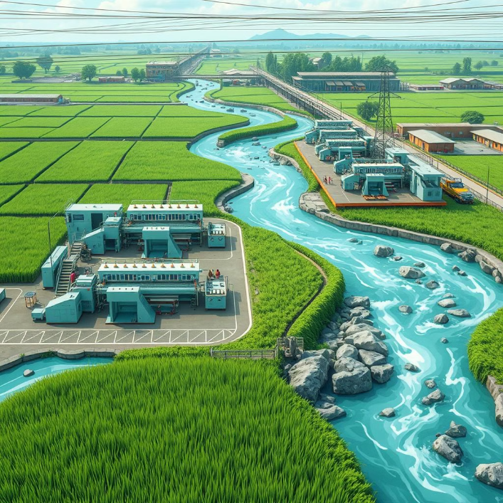
Environmental Concerns
Pakistan's textile industry has significant environmental implications, including water pollution, chemical waste, and energy consumption.
Adopting sustainable practices, such as: •
1. Save water •
2. Reduce waste •
3. Use clean energy •
would protect the environment and promote eco-friendly textiles.

Slide 16
Future Prospects: A Focus on Growth
Despite the challenges, Pakistan's textile industry has significant potential for growth, driven by rising global demand for textiles. The government is focused on increasing exports and becoming a major player in the international market by leveraging its comparative advantages.

Slide 17
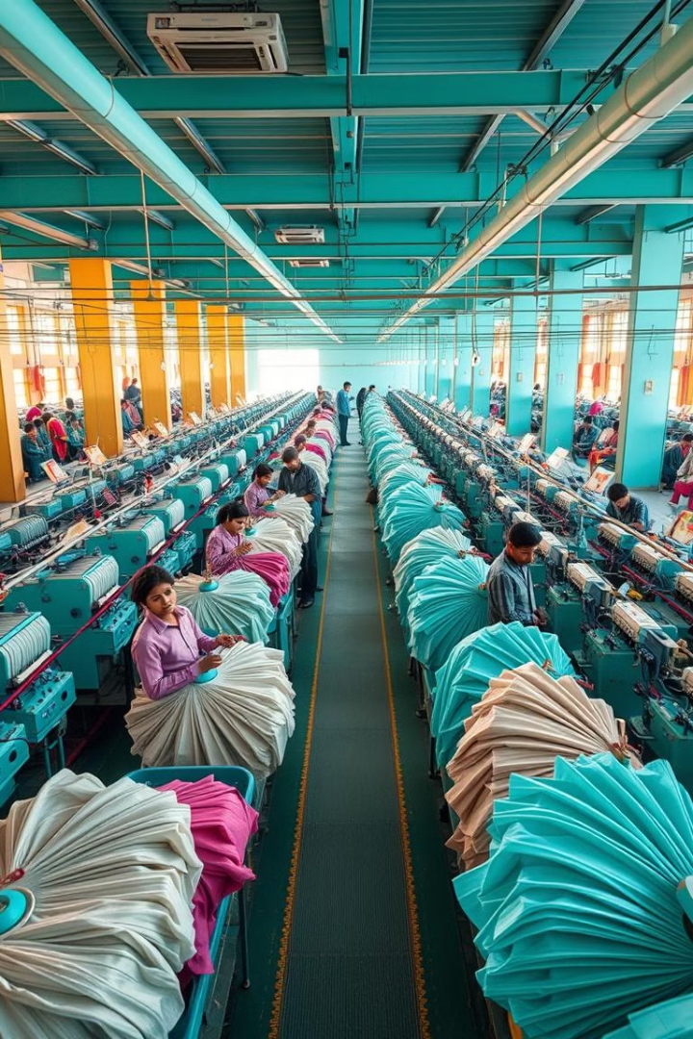

Pakistan's Textile Industry: A Global Powerhouse
Pakistan's textile industry is a major contributor to the country's economy, accounting for 60% of total exports. The industry has flourished, making Pakistan one of the world's top 10 textile exporters.
by Muhammad Arslan Sarwar

Slide 18
Top Export Destinations
United States
Germany
United Kingdom
Spain and Netherlands
Pakistan's largest textile export market, reaching $5.23 billion .
A significant market, with exports reaching $2.26 billion.
Exports to the UK reached $1.93 billion.
Exports to Spain and the Netherlands reached $1.43 billion and $1 billion, respectively.

Slide 19
Growth in Textile Exports
12.6%
8.5%
10.2%
US
Germany
UK
Textile exports to the US grew by 12.6% in Q1 2024.
Exports to Germany grew by 8.5% in Q1 2024.
Exports to the UK grew by 10.2% in Q1 2024.
12.1%
Spain
Exports to Spain grew by 12.1% in Q1 2024.

Slide 20
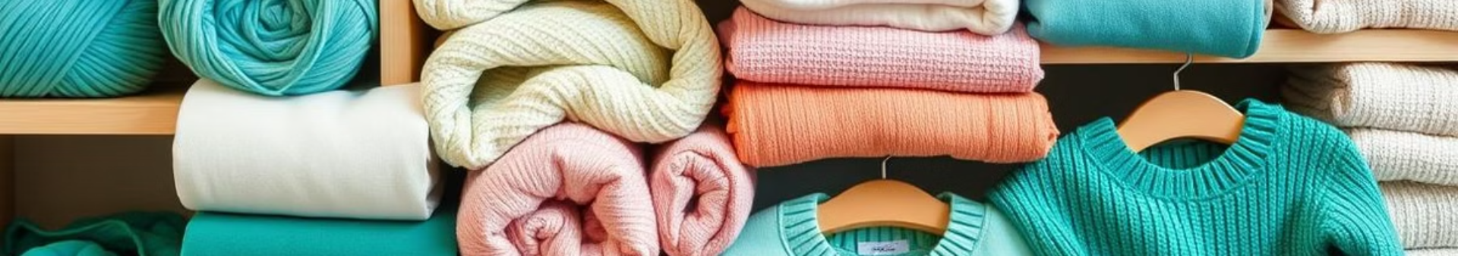
Product Categories
Cotton Yarn
Cotton Cloth
Exports grew by 15.6% to $211 million in Q1 2024.
Exports grew by 12.3% to $341 million in Q1 2024.
Towels, Bedwear, and Readymade Garments
Knitwear
Exports of knitwear grew by 11.5% to $201 million in Q1 2024.
Exports of towels, bedwear, and readymade garments grew by 10.9%, 12.1%, and 15.3%, respectively, in Q1 2024.

Slide 21

Trade Agreements and Partnerships
1
US
2
Germany
Pakistan and the US have a Trade and Investment Framework Agreement (TIFA).
Pakistan and Germany have a bilateral investment treaty.
3
UK, Spain, and Netherlands
Pakistan has bilateral trade agreements with the UK, Spain, and the Netherlands.

Slide 22
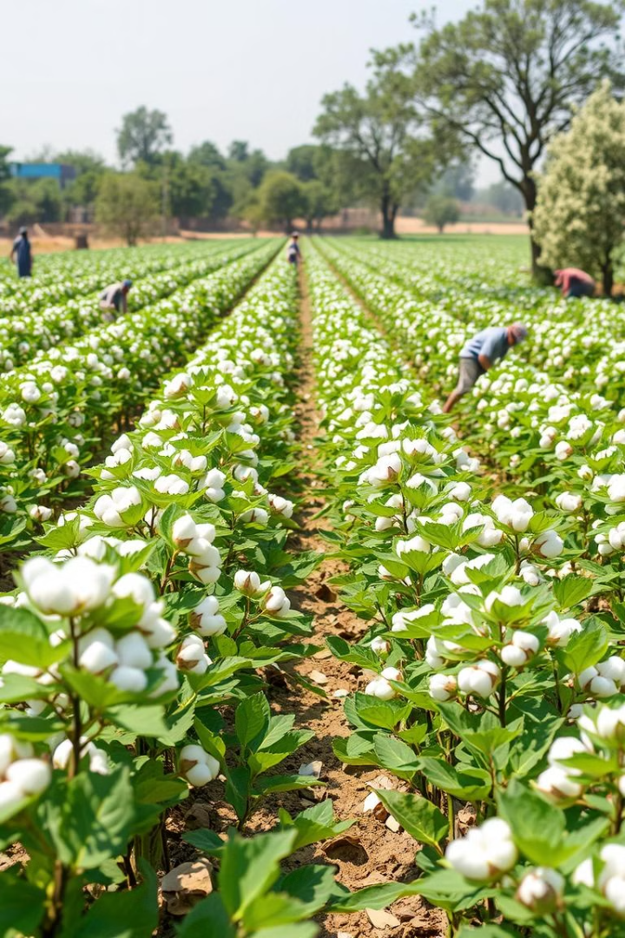



Competitive Advantages
Cotton Production
Workforce
Pakistan is a major cotton producer, providing a key raw material for the textile industry.
Pakistan has one of the largest labor force in the world.
Strategic Location
Pakistan's location provides access to major global markets.

Slide 23



Government Support
1
Infrastructure Investment
2
Initiatives
3
Industry Growth
The Pakistani government is investing in textile infrastructure and launching initiatives to support the industry's growth.

Slide 24
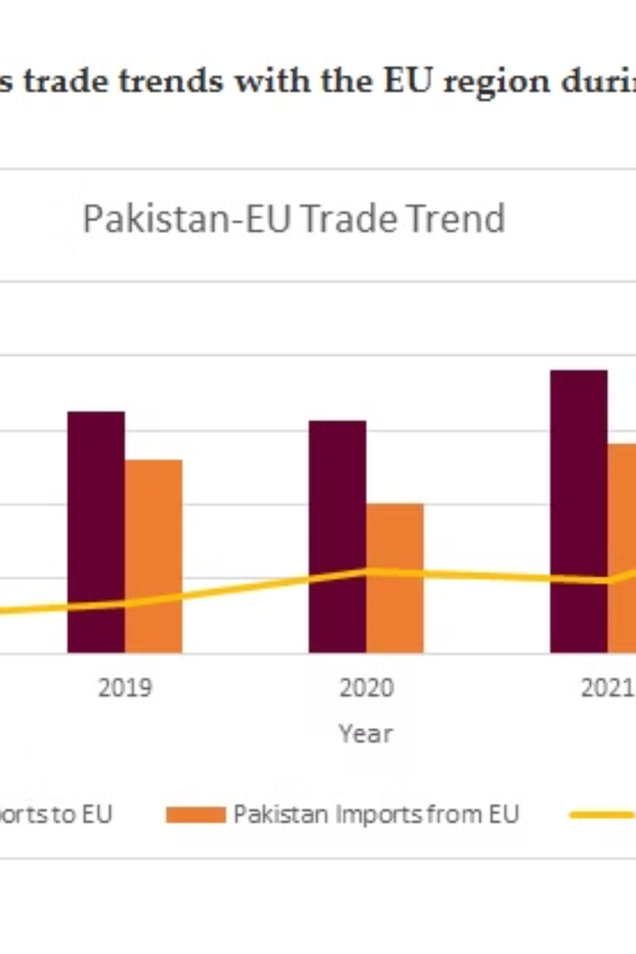
GSP+ and Pakistan's Textile Industry
Pakistan's textile industry is a major contributor to the country's economy, and the GSP+ trade agreement has played a significant role in boosting its exports.

Slide 25
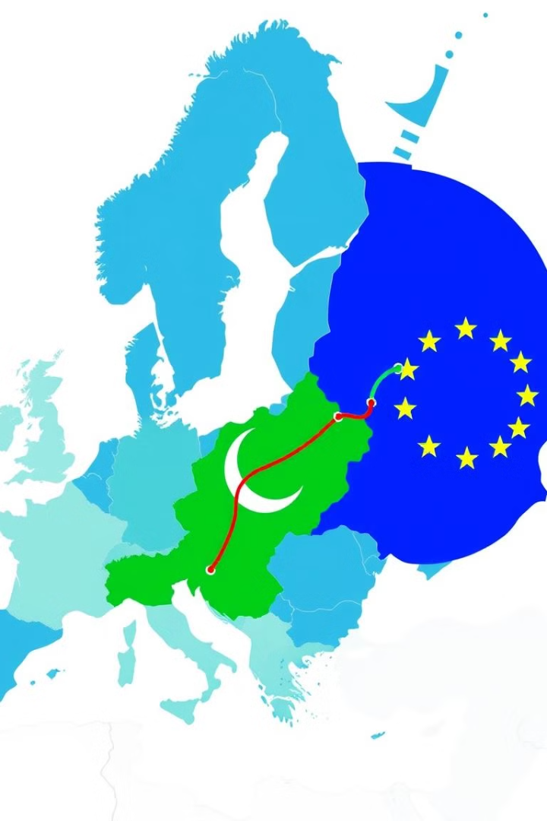
GSP+ Overview
Tariff-Free Access
Criteria
Countries must meet certain criteria, including environmental protection and good governance, to qualify for GSP+ status.
The GSP+ agreement provides tariff-free access to the EU market for developing countries.

Slide 26
Benefits of GSP+
Increased Market Access
Enhanced Competitiveness
GSP+ has significantly increased Pakistan's access to the EU market, boosting exports.
Tariff-free access has made Pakistani textiles more competitive in the EU market.

Slide 27
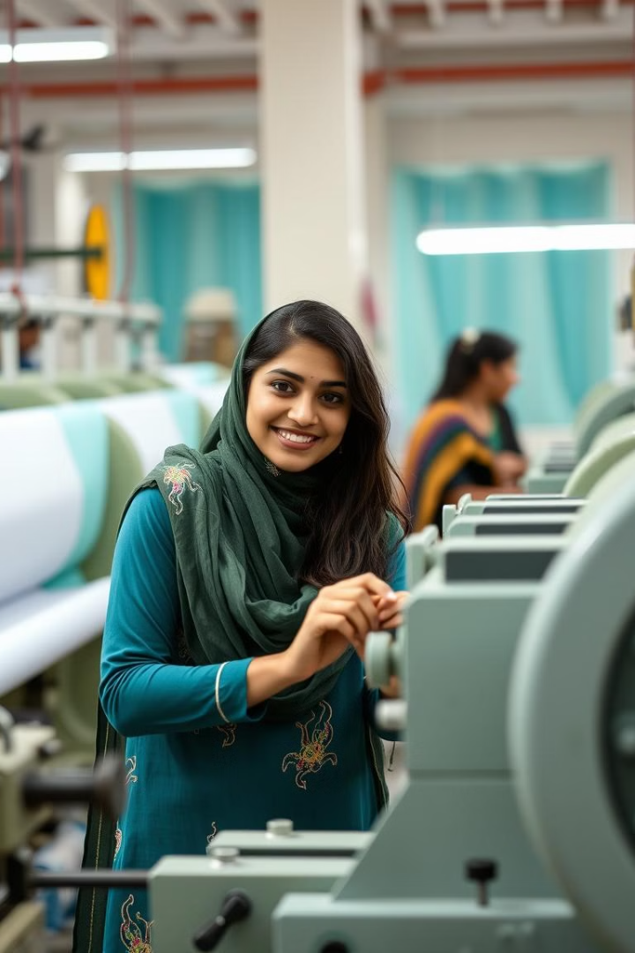
Impact on Textile Exports
66.6%
$9.3B
Growth Rate
Exports in 2024
Pakistan's textile exports to the EU have grown by 66.6% since 2013.
Pakistan exported $9.3 billion worth of textiles to the EU in FY2024.

Slide 28
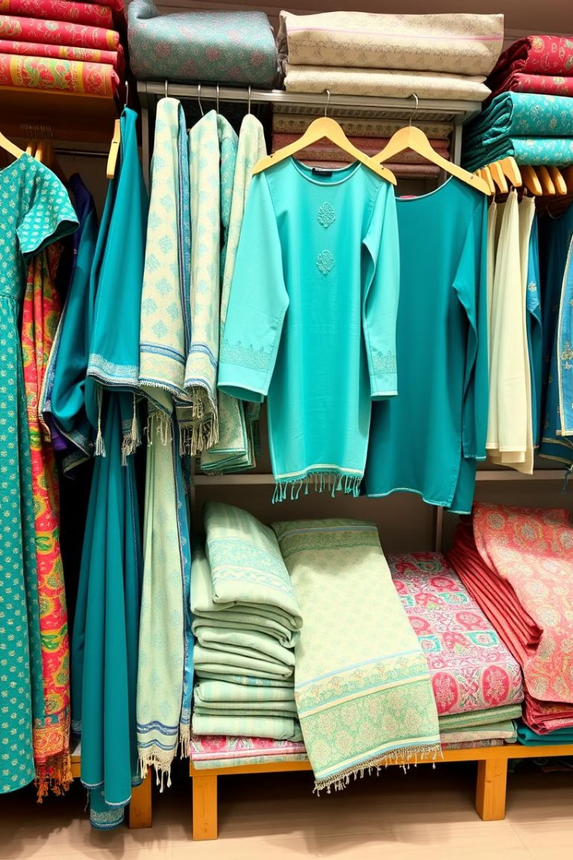
Key Benefits for Textile Industry
1
Tariff-Free Access
2
Increased Revenue
GSP+ provides tariff-free access to the EU market, making Pakistani textiles more competitive.
Textile exporters have seen a significant increase in revenue due to increased exports to the EU.
3
Job Creation
The textile industry in Pakistan employs over 10 million workers, with many more jobs created indirectly.

Slide 29
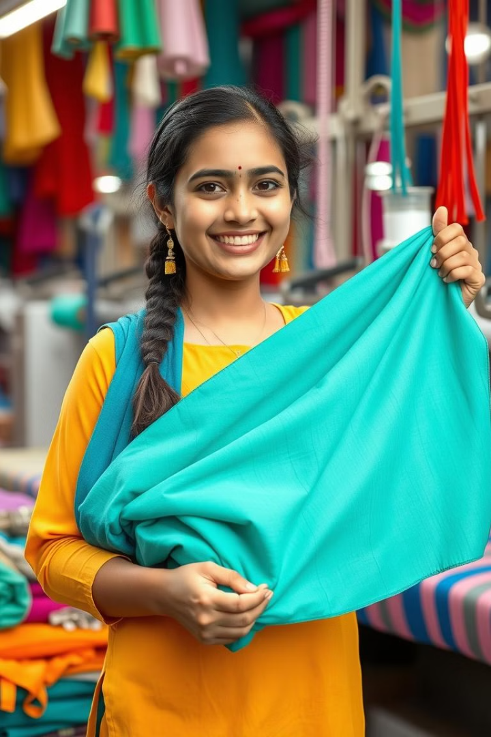
Conclusion
The GSP+ status has been a significant boost for Pakistan's textile industry, leading to increased exports, revenue, and job creation. To further capitalize on this opportunity, Pakistan needs to focus on improving its business environment and promoting exports.

